Slide 1

Data Pre-processing

Slide 2
Highlights
- What is data preprocessing?
- Why preprocess data?
- When should one data preprocess?
-How to data preprocess?
- Techniques of data preprocess

Slide 3
What is data preprocessing?
It is the aspect of transforming real world data to informative data.

Slide 4

World data
Messy
Inconsistent
Missing Values
Containing errors

Slide 5
Why preprocess data?
Data quality and accuracy to improve reliability
Improve productivity

Slide 6

When should one data
preprocess?
Right after acquiring the data

Slide 7
How to data pre-process?
Data Cleaning
Data Integration
Data transformation
Feature Engineering
Handling of Imbalanced data set
Normalization & Standardization

Slide 8
Techniques of data pre-process
1.Imputation
Regression Imputation
K-Nearest Neighbors Imputation
Hot Deck Imputation
Multiple Imputation
Interpolation
Random Imputation

Slide 9
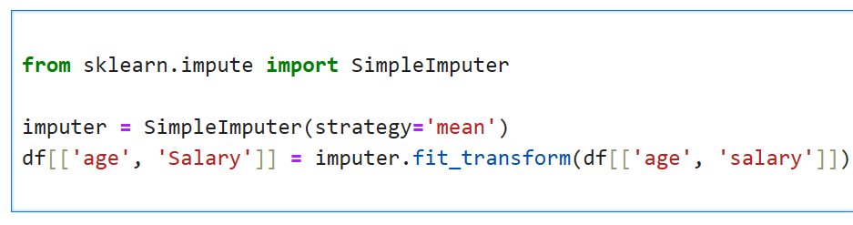
SimpleImputer

Slide 10
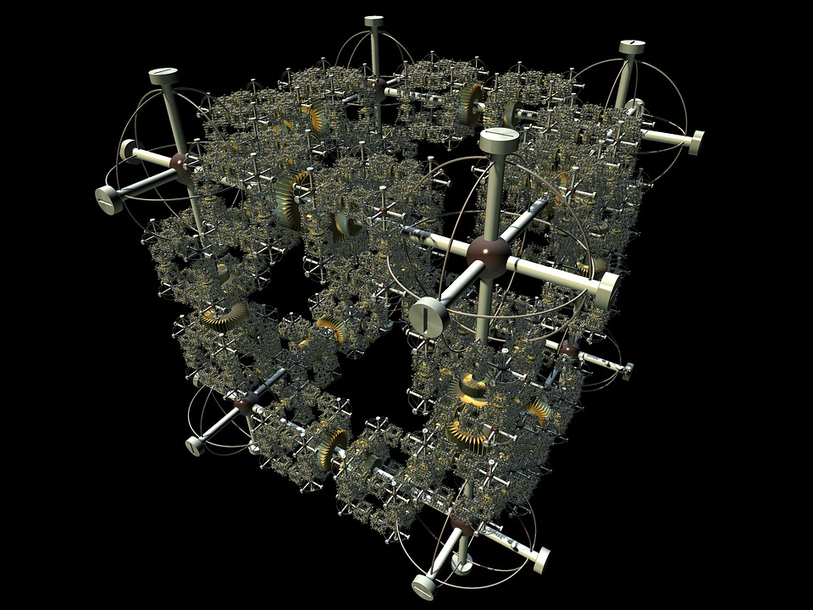
Deletion
Outliers
Encoding
Duplicates
Oversampling/Undersampling/Synthetic Data Generation
Dimensionality Reduction

Slide 11

Feature Engineering
Tokenization
Integration
Stemming
Scaling
Lemmatization

